Slide 1
GRADE 7 ACCELERATED · UNIT 3 · THREAD A · DAY 2
Negative Exponents with Variable Bases
MA.8.AR.1.1
I can rewrite an algebraic expression with negative exponents using only positive exponents, and apply several laws of exponents to a monomial expression.
Grade 7 Accelerated · Unit 3 · Thread A · Day 2 — Negative Exponents with Variable Bases
1

Slide 2
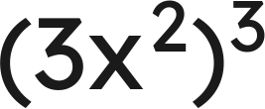

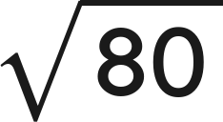

Warm-Up
1. Write as a single monomial:
2. Find the value:
3. Which is greater,
or 9?
4. What is the reciprocal of
?
Grade 7 Accelerated · Unit 3 · Thread A · Day 2 — Negative Exponents with Variable Bases
2

Slide 3

Warm-Up
1. Write as a single monomial:
27x⁶
2. Find the value:
1/25
3. Which is greater,
or 9?
9
4. What is the reciprocal of
?
Grade 7 Accelerated · Unit 3 · Thread A · Day 2 — Negative Exponents with Variable Bases
3

Slide 4
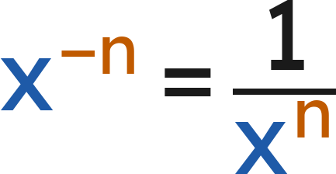
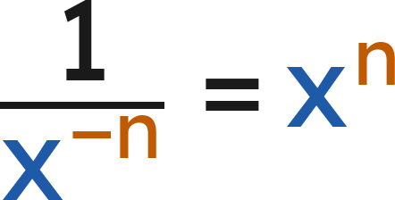

Notes
I. The pattern, with a letter
x⁴ | x³ | x² | x¹ | x⁰ | x⁻¹ | x⁻² | x⁻³
x·x·x·x | x·x·x | x·x | x | 1 | 1/x | 1/x² | 1/x³
(
)
Grade 7 Accelerated · Unit 3 · Thread A · Day 2 — Negative Exponents with Variable Bases
4

Slide 5
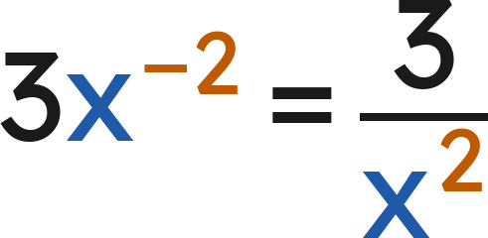
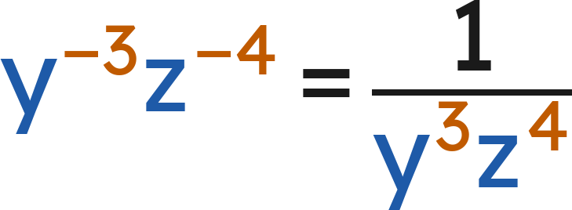
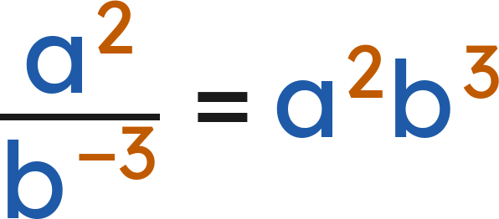
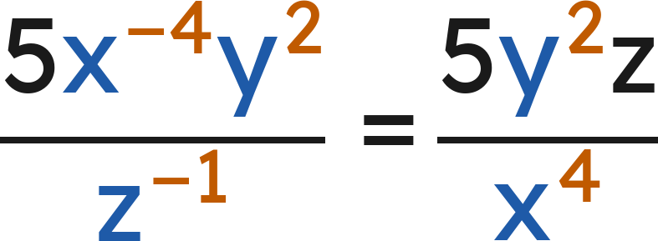
Notes
II. Moving factors across the fraction bar
Only the factor with the negative exponent moves. Its exponent turns positive.
Grade 7 Accelerated · Unit 3 · Thread A · Day 2 — Negative Exponents with Variable Bases
5

Slide 6
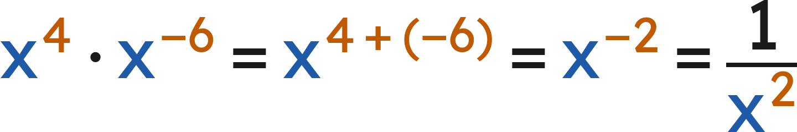
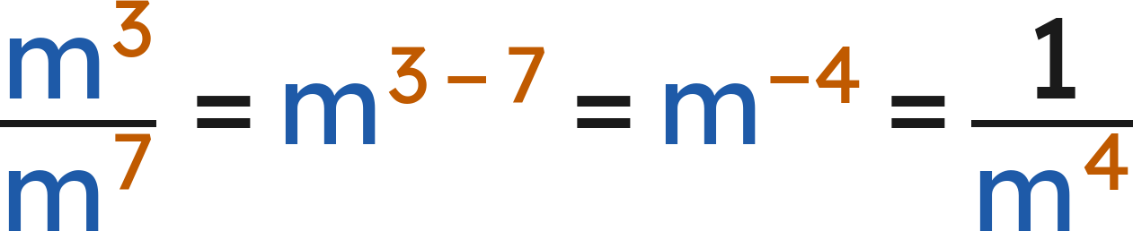
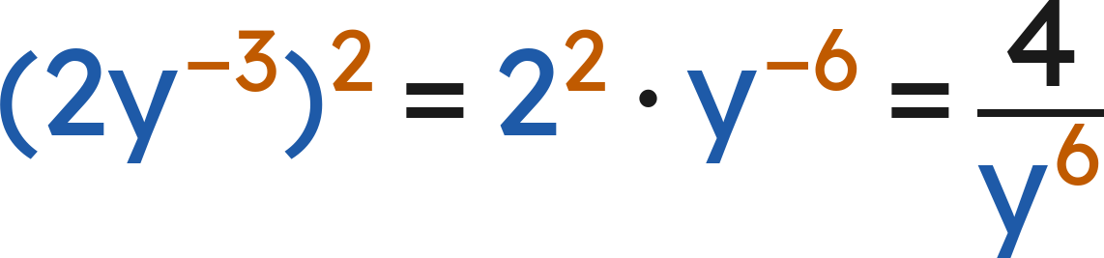
Notes
III. The laws with negative exponents
Apply the law. Then rewrite so that every exponent is positive.
Grade 7 Accelerated · Unit 3 · Thread A · Day 2 — Negative Exponents with Variable Bases
6

Slide 7
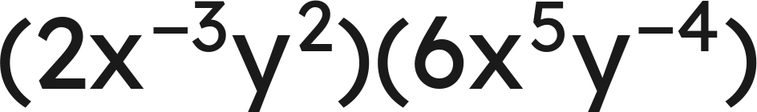
Example 1
Write an equivalent expression with positive exponents only.
Grade 7 Accelerated · Unit 3 · Thread A · Day 2 — Negative Exponents with Variable Bases
7

Slide 8
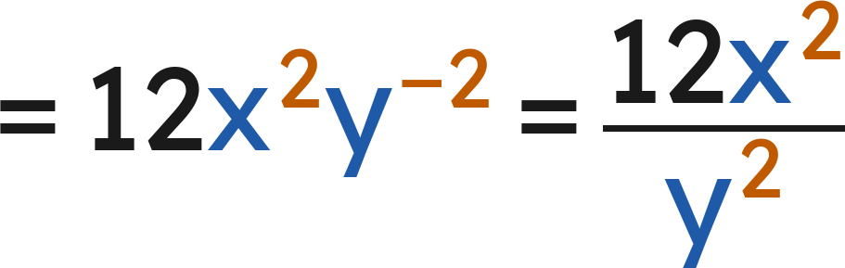
Example 1
Answer: 12x²/y²
Grade 7 Accelerated · Unit 3 · Thread A · Day 2 — Negative Exponents with Variable Bases
8

Slide 9
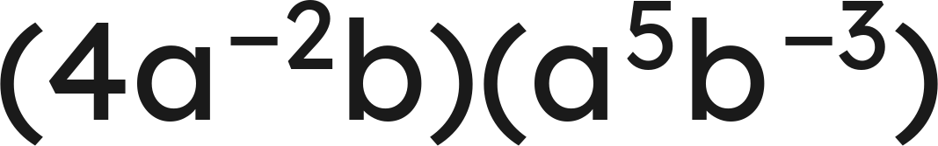
Your Turn
Write an equivalent expression with positive exponents only.
Grade 7 Accelerated · Unit 3 · Thread A · Day 2 — Negative Exponents with Variable Bases
9

Slide 10
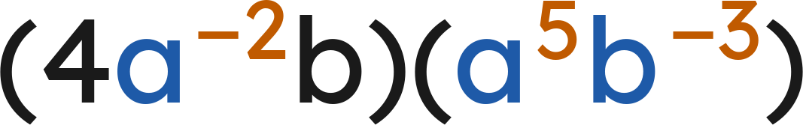

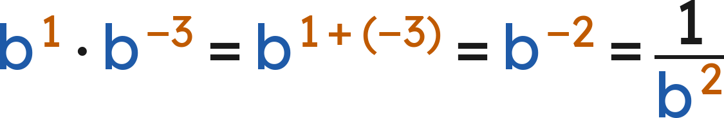
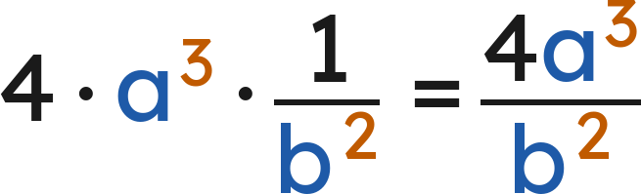
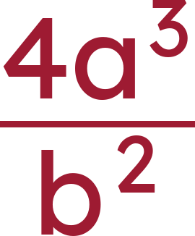
Your Turn
Write an equivalent expression with positive exponents only.
The a's:
The b's:
Answer:
Grade 7 Accelerated · Unit 3 · Thread A · Day 2 — Negative Exponents with Variable Bases
10

Slide 11
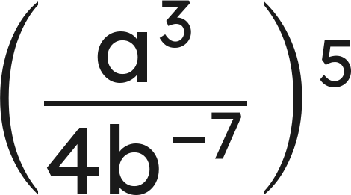
Example 2
Write an equivalent expression with positive exponents only.
Grade 7 Accelerated · Unit 3 · Thread A · Day 2 — Negative Exponents with Variable Bases
11

Slide 12
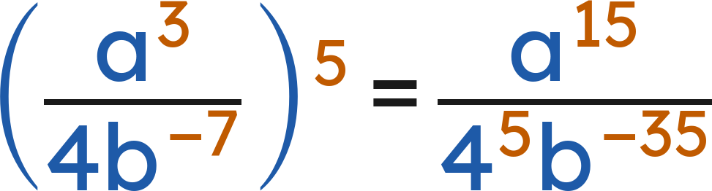
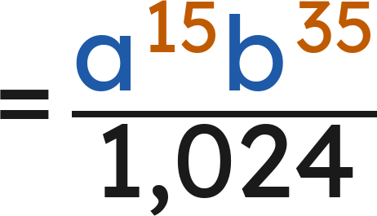
Example 2
Answer: a¹⁵b³⁵/1,024
Grade 7 Accelerated · Unit 3 · Thread A · Day 2 — Negative Exponents with Variable Bases
12

Slide 13
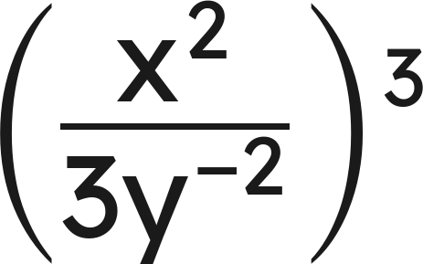
Your Turn
Write an equivalent expression with positive exponents only.
Grade 7 Accelerated · Unit 3 · Thread A · Day 2 — Negative Exponents with Variable Bases
13

Slide 14
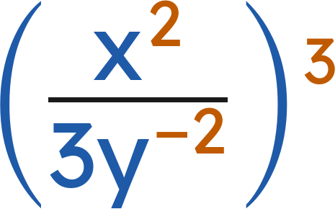
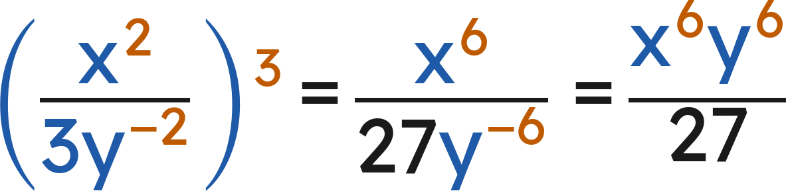
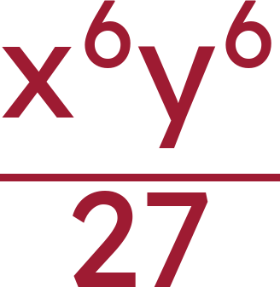
Your Turn
Write an equivalent expression with positive exponents only.
Cube every part, then move the y up:
Answer:
Grade 7 Accelerated · Unit 3 · Thread A · Day 2 — Negative Exponents with Variable Bases
14

Slide 15

Whiteboards · Question 1 of 9
Answer it.
Grade 7 Accelerated · Unit 3 · Thread A · Day 2 — Negative Exponents with Variable Bases
15

Slide 16

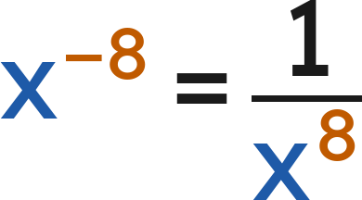

Whiteboards · Question 1 of 9
Answer:
Grade 7 Accelerated · Unit 3 · Thread A · Day 2 — Negative Exponents with Variable Bases
16

Slide 17
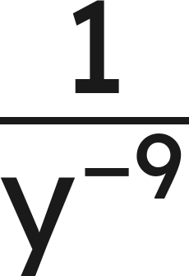
Whiteboards · Question 2 of 9
Answer it.
Grade 7 Accelerated · Unit 3 · Thread A · Day 2 — Negative Exponents with Variable Bases
17

Slide 18
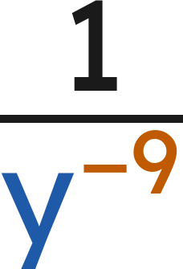
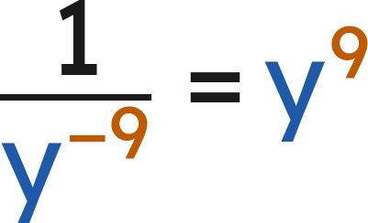

Whiteboards · Question 2 of 9
Answer:
Grade 7 Accelerated · Unit 3 · Thread A · Day 2 — Negative Exponents with Variable Bases
18

Slide 19


Whiteboards · Question 3 of 9
The brightness of a lamp from
meters away is
units.
The lamp is 15 centimeters tall.
How bright is the lamp from 3 meters away?
Answer it.
Grade 7 Accelerated · Unit 3 · Thread A · Day 2 — Negative Exponents with Variable Bases
19

Slide 20

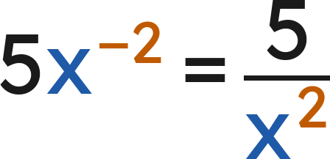
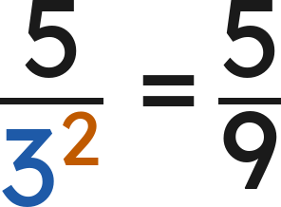


Whiteboards · Question 3 of 9
The brightness of a lamp from
meters away is
units.
The lamp is 15 centimeters tall.
How bright is the lamp from 3 meters away?
When
:
Answer:
Grade 7 Accelerated · Unit 3 · Thread A · Day 2 — Negative Exponents with Variable Bases
20

Slide 21

Whiteboards · Question 4 of 9
Answer it.
Grade 7 Accelerated · Unit 3 · Thread A · Day 2 — Negative Exponents with Variable Bases
21

Slide 22

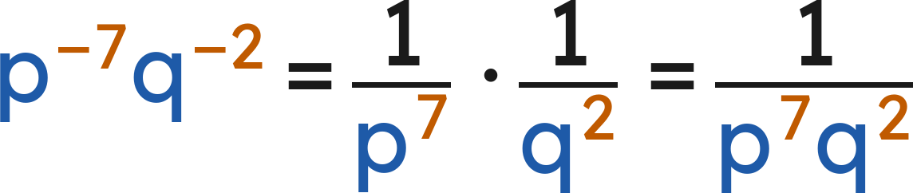
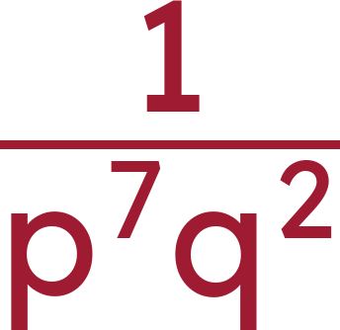
Whiteboards · Question 4 of 9
Answer:
Grade 7 Accelerated · Unit 3 · Thread A · Day 2 — Negative Exponents with Variable Bases
22

Slide 23
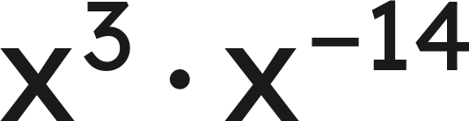
Whiteboards · Question 5 of 9
Which expression is equivalent?
A. −x¹¹
B. 1/x⁴²
C. 1/x¹¹
D. x¹⁷
Answer it.
Grade 7 Accelerated · Unit 3 · Thread A · Day 2 — Negative Exponents with Variable Bases
23

Slide 24

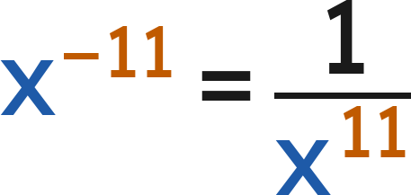
Whiteboards · Question 5 of 9
Which expression is equivalent?
Answer: C — 1/x¹¹
Grade 7 Accelerated · Unit 3 · Thread A · Day 2 — Negative Exponents with Variable Bases
24

Slide 25
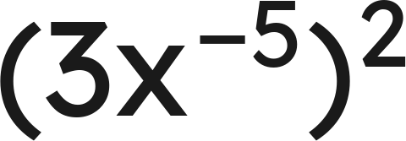
Whiteboards · Question 6 of 9
Which expression is equivalent?
A. 9/x³
B. 1/(9x¹⁰)
C. 3/x¹⁰
D. 9/x¹⁰
Answer it.
Grade 7 Accelerated · Unit 3 · Thread A · Day 2 — Negative Exponents with Variable Bases
25

Slide 26

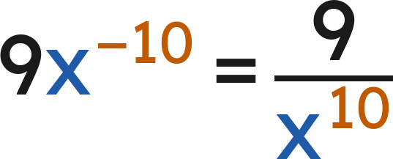
Whiteboards · Question 6 of 9
Which expression is equivalent?
Answer: D — 9/x¹⁰
Grade 7 Accelerated · Unit 3 · Thread A · Day 2 — Negative Exponents with Variable Bases
26

Slide 27
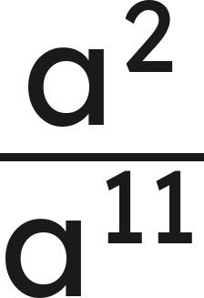
Whiteboards · Question 7 of 9
Answer it.
Grade 7 Accelerated · Unit 3 · Thread A · Day 2 — Negative Exponents with Variable Bases
27

Slide 28
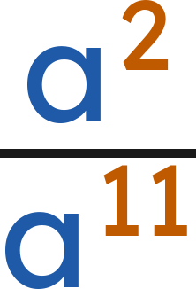
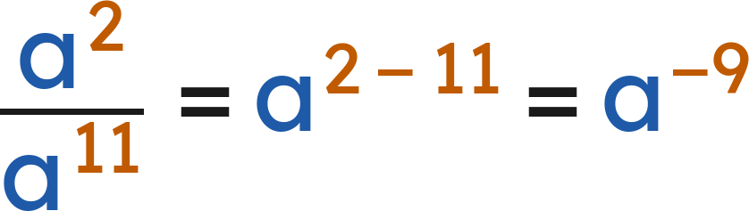
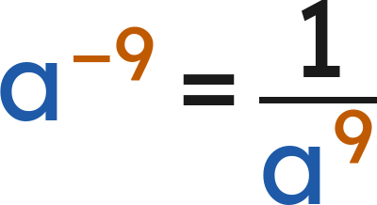

Whiteboards · Question 7 of 9
Answer:
Grade 7 Accelerated · Unit 3 · Thread A · Day 2 — Negative Exponents with Variable Bases
28

Slide 29


Whiteboards · Question 8 of 9
Find the value of
:
Answer it.
Grade 7 Accelerated · Unit 3 · Thread A · Day 2 — Negative Exponents with Variable Bases
29

Slide 30



Whiteboards · Question 8 of 9
Find the value of
:
Same base, so the exponents add:
Answer: n = 7
Grade 7 Accelerated · Unit 3 · Thread A · Day 2 — Negative Exponents with Variable Bases
30

Slide 31



Whiteboards · Question 9 of 9
How are
and
related?
Explain, and give the value of each when
.
Write your answer in sentences.
Grade 7 Accelerated · Unit 3 · Thread A · Day 2 — Negative Exponents with Variable Bases
31

Slide 32


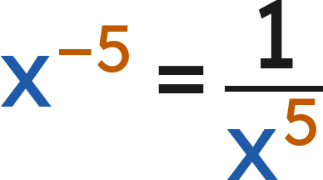

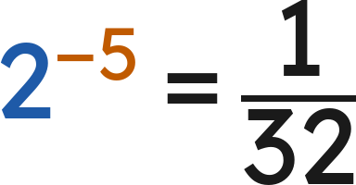


Whiteboards · Question 9 of 9
How are
and
related?
Explain, and give the value of each when
.
, the reciprocal of
When
:
and
Answer: x⁻⁵ is the reciprocal of x⁵. When x = 2: x⁵ = 32 and x⁻⁵ = 1/32.
Grade 7 Accelerated · Unit 3 · Thread A · Day 2 — Negative Exponents with Variable Bases
32

Slide 33

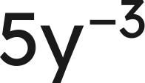
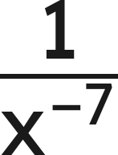

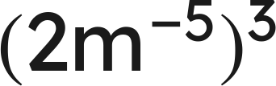


Independent Set
1.
Rewrite using only positive exponents.
2.
Rewrite using only positive exponents.
3.
Rewrite using only positive exponents.
4.
Simplify. Use positive exponents only.
5.
Simplify. Use positive exponents only.
6.
Find the value of
.
Grade 7 Accelerated · Unit 3 · Thread A · Day 2 — Negative Exponents with Variable Bases
33

Slide 34
IXL
1.
Open IXL and start today's skills.
2.
Work on paper where the question needs work. The answer box does not show it.
3.
Every skill listed is required, to a SmartScore of 67. Due at the start of the next class.
Today's skills — all required
Variables with negative exponents — 2NL
Multiply and divide powers: variable bases — 85P
Grade 7 Accelerated · Unit 3 · Thread A · Day 2 — Negative Exponents with Variable Bases
34

